Slide 1
Milestone 2 – Project Plan

Slide 2
Motivation
“If you fail to plan, you are planning to fail!”
- Benjamin Franklin
“Planning is like a roadmap that leads you to your destination”
- Topsy Gift
Milestone 2 – Project Plan

Slide 3
Benefit
Gives an Overview of the project
Focus at activity
Easier to Track progress
Helps preparing Report
Milestone 2 – Project Plan

Slide 4
Project Schedule
Milestone 2 – Project Plan

Slide 5
Cost Plan
Milestone 2 – Project Plan

Slide 6
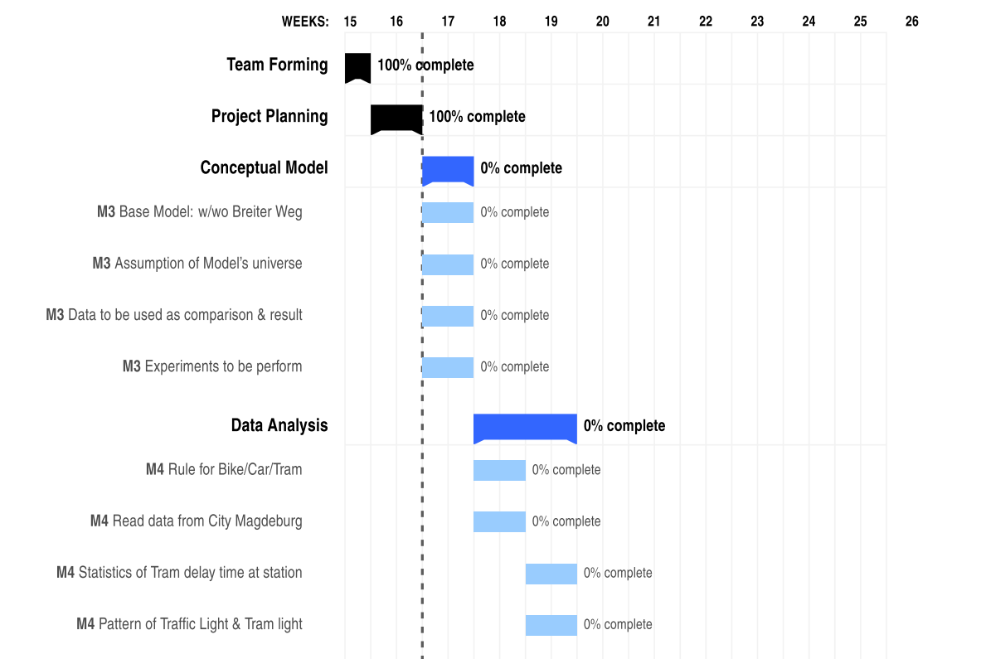
Project Gantt Chart
Milestone 2 – Project Plan

Slide 7
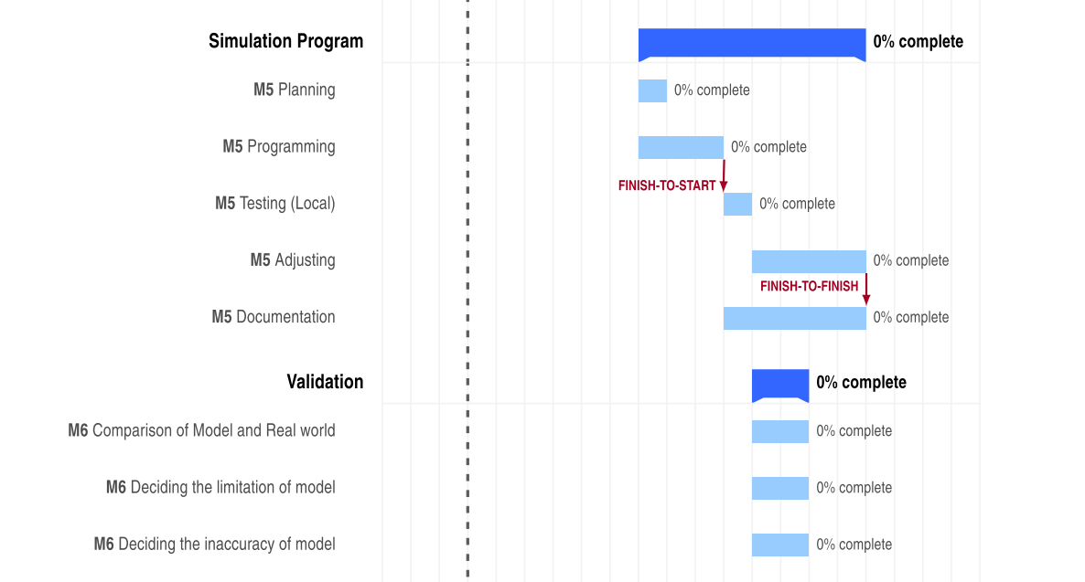
Project Gantt Chart
Milestone 2 – Project Plan

Slide 8
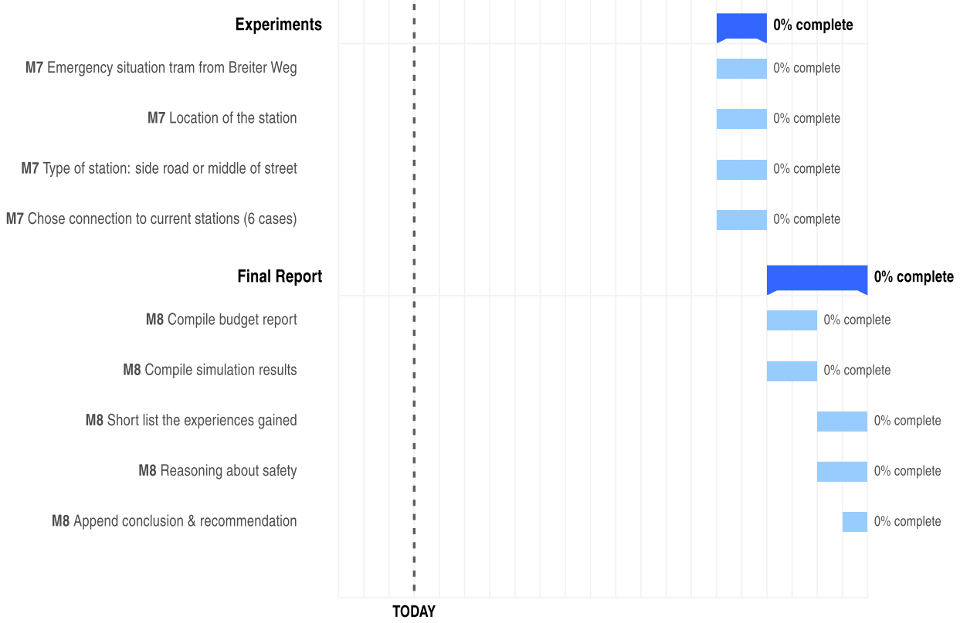
Project Gantt Chart
Milestone 2 – Project Plan

Slide 9
SIMTECH – So Far
Budget: 7.450 € spent
Lesson learned: Delegation
One person in charge
Delegate the task when no volunteers
Milestone 2 – Project Plan

Slide 10
“Plan on the go. Go with the flow.”
- Haresh Sippy
THANK YOU FOR YOUR ATTENTION
Milestone 2 – Project Plan

